Slide 1
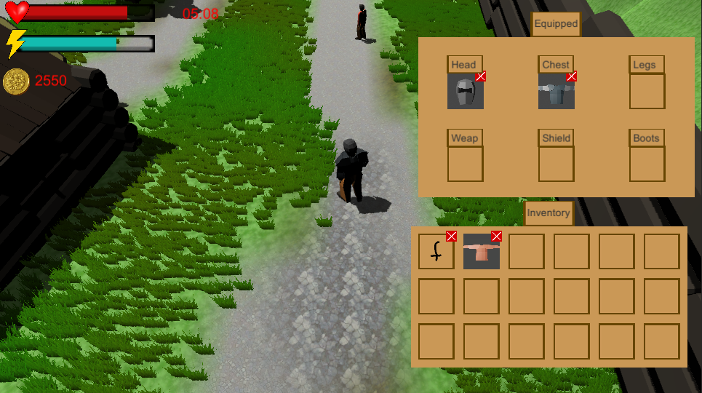
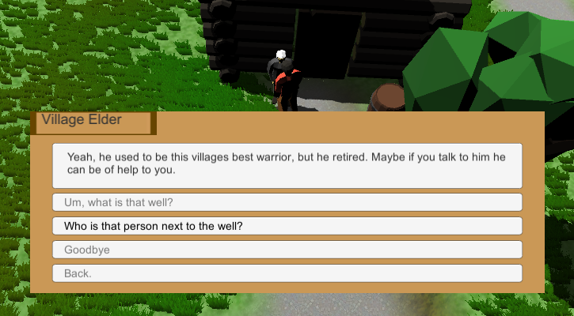
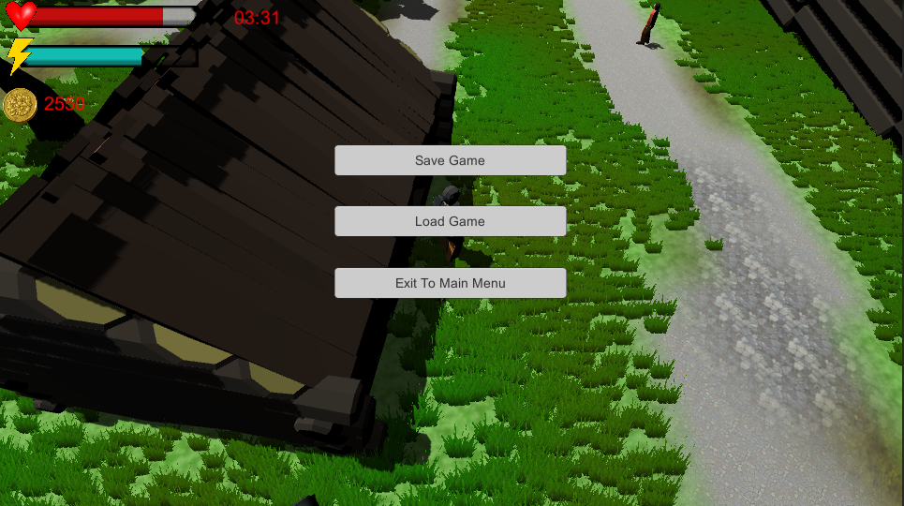
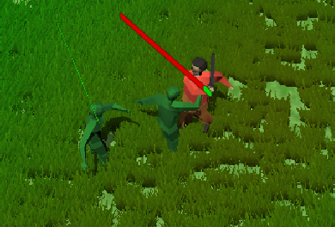
Abstract A 3-Dimensional Role-Playing Game made in Unity Engine. The game aims to entertain people.
Warriors Trial – A 3D RPG Game
Lütfullah Kor 170706001
Deniz Keskin 170706028
Arda Yılmazlar 170706013
Software Engineering
2020-2021 Capstone Project
Problem
People always want to entertain themselves, and one tool for entertainment is games.
One game genre is Role-Playing Games, as Role-Playing Games offer a great experience with built-in mechanics
Such as quests, dialogues and trading we decided to make a Role-Playing Game.
Results and Discussion
Developing a game is not as easy as it seems, every component has to be designed and implemented carefully.
Having multiple classes that are connected to each other, is difficult to manage and debug. The difficulty increases exponentially with the number of classes.
Figure 1. Inventory and Equipped items.
Figure 2. NPC Dialogues
Figure 3. In Game Menu)
Figure 4. Combat
Introduction
- Offering different game mechanics, and a story through NPC interactions such as dialogues and quests.
- We aim to give the player an incentive to progress through the game.
Suggestions
- Merchants and trading system.
- Skill menu to manage skills.
- Level system and skill points.
Methods
In order to bind together objects, scripts and assets, Unity Engine was used.
In order to design assets such as; trees, houses, equipment, animations etc. Blender was used.
In order to write the scripts that dictate how the game world behaves Visual Studio was used.
Resources
- https://unity.com/ - https://docs.unity3d.com/
- https://forum.unity.com/
- https://youtube.com/
- https://stackoverflow.com/
- https://blender.org/
- https://docs.blender.org/
- https://github.com/
Similar Products:
- Grim Dawn
- Diablo Series
- Runescape

